Slide 1
Personalized Workout & Diet Planner
CAPSTONE PROJECT
Presented By:
Student Name- Abhilasha Jugalkishor Rathi
College Name- Zeal College of Engineering and Research
Department- Computer Engineering

Slide 2
OUTLINE
Problem Statement (Should not include solution)
Proposed System/Solution
System Development Approach (Technology Used)
Algorithm & Deployment
Result
Conclusion
Future Scope
References

Slide 3
Problem Statement
.
Most fitness applications provide generic workout and diet plans that do not consider individual differences among students.
Students have:
Different body types and health goals
Cultural food preferences
Limited budgets
Limited access to gym equipment (especially hostel students)
Because of these constraints, students struggle to follow unrealistic fitness plans.
There is a need for an intelligent system that understands student lifestyle and generates personalized, practical, and affordable fitness guidance.

Slide 4
Proposed Solution
We propose an AI-powered system that:
Predicts personalized calorie requirements
Generates goal-based workout plans
Suggests culturally adaptable meal plans
Recommends budget-friendly diet options
Adjusts workouts based on available resources (Home / Gym / Hostel)
The system uses Machine Learning to provide customized, realistic, and practical fitness guidance.

Slide 5
System Approach
Frontend:
Streamlit (Interactive Web App)
Backend:
Python
Machine Learning:
Scikit-learn
Numpy
Pickle (Model Serialization)
Development Steps:
Data collection for calorie prediction
Model training
Model deployment
UI integration using Streamlit

Slide 6
Algorithm & Deployment
Algorithm Used:
Linear Regression (Calorie Prediction Model)
Steps:
Take user input (Age, Weight, Height, Activity Level)
Predict daily calorie requirement
Based on goal → Generate workout plan
Based on culture & budget → Generate diet plan
Deployment:
Localhost using Streamlit
Can be deployed on:
  Streamlit Cloud
  Heroku
  AWS
.

Slide 7
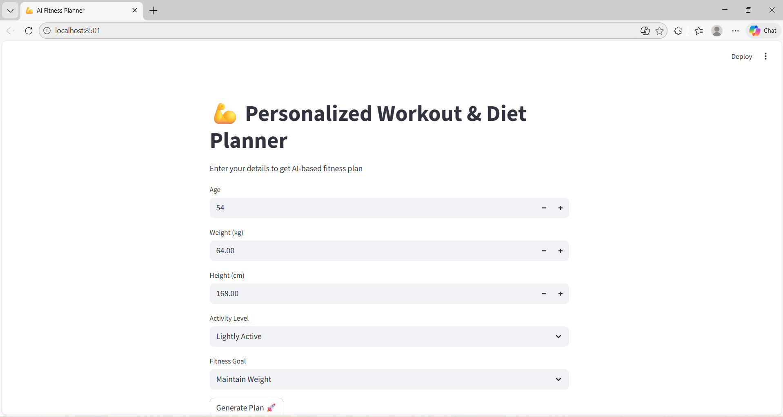
Result
.

Slide 8
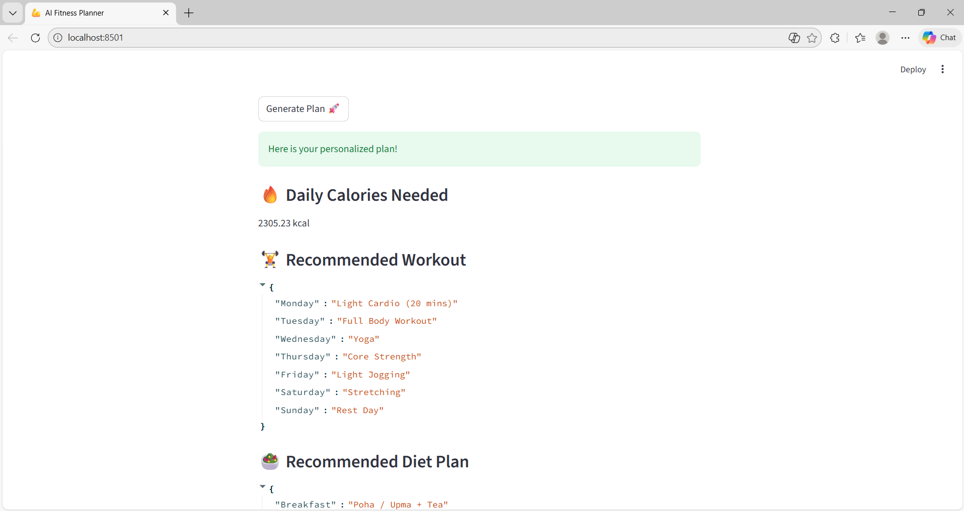
Result

Slide 9
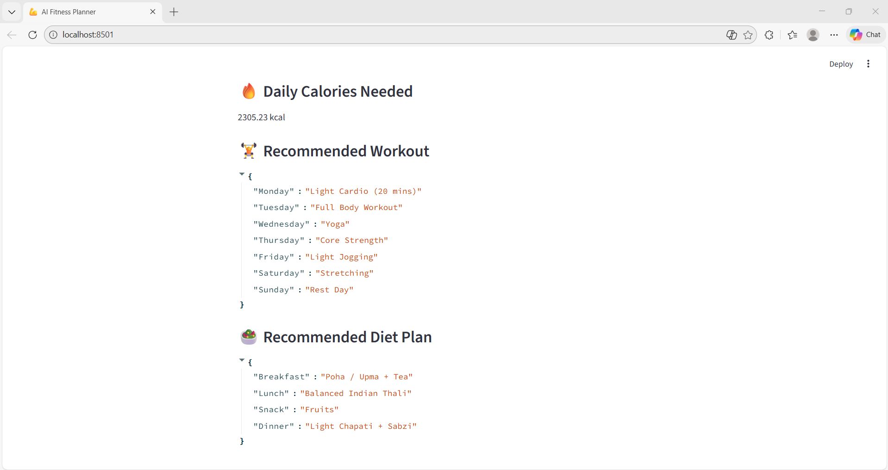
Result

Slide 10
Conclusion
The AI-based Personalized Workout & Diet Planner successfully addresses the problem of generic fitness plans by providing:
Personalization
Practicality
Cultural adaptability
Budget awareness
It improves accessibility of fitness guidance for students.

Slide 11
Future scope
Integration with wearable devices
AI Chatbot fitness assistant
BMI & health risk prediction
Region-based food database
Real-time progress tracking
Mobile application version

Slide 12
References
Scikit-learn Documentation
Streamlit Official Documentation
Research papers on calorie prediction
WHO Nutrition Guidelines
Kaggle Datasets

Slide 13
Github link
Github Link : https://github.com/Abhi2203-Engg/AI-ML-Project.git
Deployment Link: Streamlit link:-https://ai-ml-project-8czaw4e798ez6bqnruysdv.streamlit.app/

Slide 14
THANK YOU

